Slide 1
Raw Western Blots & Gels

Slide 2
Figure 2D, Supplementary 1B
Western blots – 6 cell lines treated with DMSO or corin (24h, 2.5uM). Probed for U2AF2, ALYREF, RBMX, and GAPDH

Slide 3
Replicate 1: ALYREF

Slide 4
Replicate 1: U2AF2

Slide 5
Replicate 1: RBMX

Slide 6
Replicate 1: GAPDH

Slide 7
Replicate 2: ALYREF

Slide 8
Replicate 2: U2AF2

Slide 9
Replicate 2: RBMX

Slide 10
Replicate 2: GAPDH

Slide 11
Replicate 3: ALYREF

Slide 12
Replicate 3: U2AF2

Slide 13
Replicate 3: RBMX

Slide 14
Replicate 3: GAPDH

Slide 15
Figure 4B, Supplementary 6A
Gels – SKMEL5 cell lines treated with DMSO or corin (24h, 2.5uM). PCR products for TJP1 exon 20, MYO1B exon 23, FN1 exon 33

Slide 16
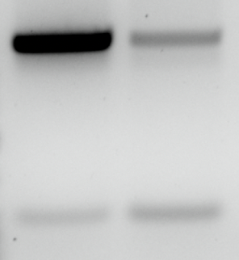
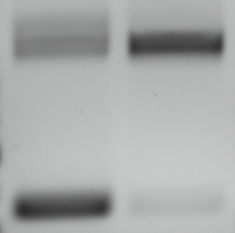
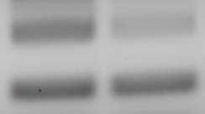
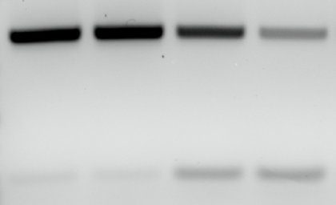
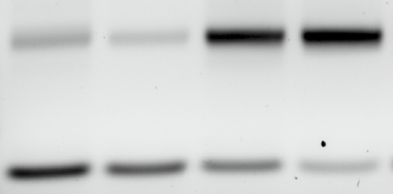
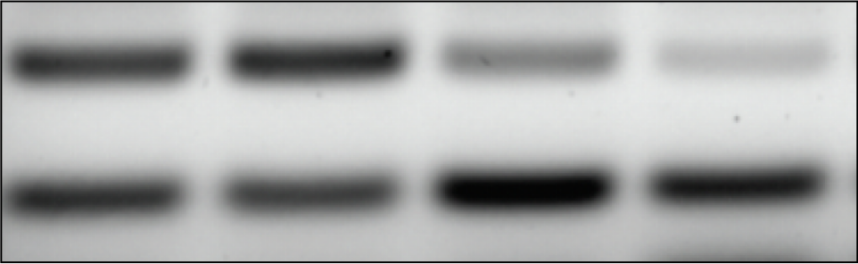
FN1 – Exon 33
TJP1 – Exon 20
MYO1B – Exon 23
DMSO
Corin
DMSO
Corin
DMSO
Corin
FN1 – Exon 33
TJP1 – Exon 20
MYO1B – Exon 23
DMSO
Corin
DMSO
Corin
DMSO
Corin

Slide 17
Rep1 – FN1, MYO1B, TJP1
FN1
TJP1
MYO1B

Slide 18
Rep 2 – TJP1 & MYO1B
TJP1
MYO1B

Slide 19
Rep 2 – FN1
FN1

Slide 20
Rep 3 – FN1
DMSO
Corin

Slide 21
Rep 3 – TJP1
DMSO
Corin

Slide 22
Rep 3 – MYO1B
DMSO
Corin
Corin
DMSO

Slide 23
Figure 4E, Supplementary 6B
Gels – SKMEL5 cell lines treated with DMSO, GSK-LSD1, MS275, GSK-LSD1 + MS275, or corin (24h, 2.5uM). PCR products for TJP1 exon 20, MYO1B exon 23, FN1 exon 33

Slide 24
Replicate 1&2: FN1
Rep1
Rep2

Slide 25
Replicate 3: FN1

Slide 26
Replicate 1&2: TJP1
Rep1
Rep2

Slide 27
Replicate 3: TJP1

Slide 28
Replicate 1&2: MYO1B
Rep1
Rep2

Slide 29
Replicate 3: MYO1B

